Slide 1


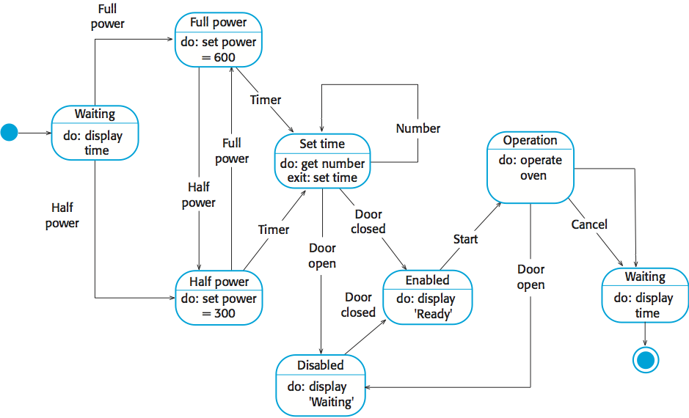
Research: from a range of research about autonomous agents and warehouse managements I’ve found that certain companies have moved to all robot sorting which has drastically affected the risk of injury and the efficiency in the warehouse. This is a great pro of using robots as companies would be able to have a higher productivity. However, on the downside it could limit and risk the quantity of jobs available. As quoted from (Keeping Up With Amazon: How Warehouse Robots Are Revolutionizing The On-Demand Economy) “warehouse robots don’t necessarily need to do all of the job”. This revealed in my research that by using the robots it greatly helps the warehouse productivity but shows that its even more efficient to combine robots with human power.
UFCFXK-30-3: Digital Systems Project
Student name:
Project Title:
A QR Code link to your video submission
Abstract:
The goal of the project is to make a simulation of autonomous agents within a warehouse scenario collecting and moving pallets of items around and storing the efficiently. This is to show the efficiency and reduction of injury when using the robots compared to human power
Design, Implementation & Testing
State Diagram
Aims and objectives:
The main aim of the project is to make a working simulation of robots working in a warehouse.
The main project objectives are:
A working simulation of a warehouse
Scalable factors to show the difference when altering facts
Create collisions to allow the robots to avoid walls and each other
Have percentages and graphs to show the productivity
Testing
For testing I plan on testing as I go creating chunks on changes and running the simulation to see the changes on all the code. This allows me to see when and where issues are created rather than doing large quantities and then having to search for the issues. By working class by class or function by function.
Planning and Management: I have chosen to use github as a management system due to its wide uses and the ability to access it anywhere. For the planning I am using a gantt chart to create a timeline for the tasks to be complete. Both of these applications and methods allow for me to create a simplistic but effective planning for the project.
The project is split mostly into 3 main steps so I can equally divide the task up.
1st step: Research and Development
This step focusses on find and researching documents and articles relating to the project. Also creating a step-by-step process to creating the project and how I aim to go about completing it.
2nd step: Main Development
This step is the main chunk of the project and aims to create the bulk of the project. Using the research and guide created in the first step the project can be constructed whilst following a stricter timeline as there is a set path to follow along.
3rd step: Review and Changes
This final step is to be set after the project is mostly completed and running. Then I can go back through and check all the code and make any changes to the code to improve the quality and fix any bugs that might cause issues
Key requirements:
Functional:
The simulation must function as intended and provide a complete scenario
The simulation must have working autonomous agents completing tasks
The simulation should scale variables to test multiple things
The simulation should have collisions between the walls and bots
Non-functional:
The simulation must have extra features such as requesting items
The simulation must a variety of layouts of warehouses
The simulation should have collisions between the pallets and the bots
The simulation should be visually applying and demonstrate the correct things
References:
Koetsier, J. (2022) ‘Keeping up with Amazon: How warehouse robotics is revolutionizing the on-demand economy’, Forbes, 4 April. Available at: https://www.forbes.com/sites/johnkoetsier/2022/04/04/keeping-up-with-amazon-how-warehouse-robotics-is-revolutionizing-the-on-demand-economy/ (Accessed: 4 November 2024). NetSuite (no date) ‘Warehouse robotics’, NetSuite. Available at: https://www.netsuite.com/portal/resource/articles/ecommerce/warehouse-robotics.shtml (Accessed: 4 November 2024). BBC News (2020) ‘Amazon’s warehouse robots increase efficiency but could lead to job losses’, BBC News, 13 November. Available at: https://www.bbc.co.uk/news/business-54902518 (Accessed: 5 November 2024). BBC News (2021) ‘How warehouse robots are transforming the supply chain’, BBC News, 2 June. Available at: https://www.bbc.co.uk/news/technology-57332390 (Accessed: 10 November 2024). Kembro, J., Näslund, D. and Olhager, J. (2017) ‘Information sharing across multiple supply chain tiers: A Delphi study on antecedents’, International Journal of Production Research, 55(7), pp. 2047-2066. Available at: https://www.tandfonline.com/doi/full/10.1080/00207543.2016.1165880 (Accessed: 10 November 2024). Supply Chain Management Review (no date) ‘Warehousing efficiency and effectiveness in the supply chain process’, Supply Chain Management Review. Available at: https://www.scmr.com/article/warehousing_efficiency_and_effectiveness_in_the_supply_chain_process (Accessed: 14 November 2024)

